Slide 1
#1: The structure and governance of…
Grey balloons provide comments to specific items
Please watch in presentation mode…
If the presentation goes too slow/fast, you can jump forward/ back using the arrow keys

Slide 2
University of Cologne
Department of Geosciences
Geology & Mineralogy, Crystallography
Geography
The subjects are intimately linked to the * Institute of Geography; * Institute of Geology and Mineralogy;
* Institute for Geophysics and Meteorology
Within the Geosciences at Cologne, doctoral candidates can pursue a doctorate in one of five subjects.
Geophysics, Meteorology

Slide 3
University of Cologne
Department of Geosciences
Geology & Mineralogy, Crystallography
Geography
Geophysics, Meteorology
The GSGS is open to doctoral candidates in all geoscience subjects

Slide 4
University of Cologne
Department of Geosciences
Further members are ‘advisors’ with the official right to supervise a doctoral candidate in any geoscience subject and who are members of the Faculty of Mathematics and Natural Sciences.
Geology & Mineralogy, Crystallography
Geography
non-professorial
academic staff (Dr)
Geophysics, Meteorology
Academic staff with a doctorate degree can be a candidate’s ‘mentor’ (or co-advisor). They are or become GSGS members.
supervising members (Prof/PD)
External supervisors (‘mentors’ or co-advisors) apply for membership when joining a candidate’s thesis advisory committee.
external supervising members (Prof/Dr)
GSGS members are not only doctoral candidates…
doctoral candidate members

Slide 5
University of Cologne
Department of Geosciences
Geology & Mineralogy, Crystallography
Geography
non-professorial
academic staff (Dr)
Geophysics, Meteorology
supervising members (Prof/PD)
All important decisions are taken by the six members of the GSGS Steering Committee
The GSGS coordinator is a consulting member without a vote
external supervising members (Prof/Dr)
(StCom)
Steering Committee
coord
doctoral candidate members,
jointly called
“Doctoral Assembly”

Slide 6
University of Cologne
Department of Geosciences
Geology & Mineralogy, Crystallography
Geography
non-professorial
academic staff (Dr)
Geophysics, Meteorology
One academic staff member with a doctorate represents the academic staff of all subjects
Three professors each represent one or two of the five subjects
supervising members (Prof/PD)
Two doctoral representatives represent the doctoral candidates. One is an academic staff member (>49% contract); one has ‘student’ status (<50% contract, scholarship, etc.)
external supervising members (Prof/Dr)
(StCom)
Steering Committee
The ‘student’ member was introduced with the new GSGS statutes (‘Ordnung’) of 12/02/2021.
coord
doctoral candidate members,
jointly called
“Doctoral Assembly”

Slide 7
University of Cologne
Department of Geosciences
Geology & Mineralogy, Crystallography
Geography
non-professorial
academic staff (Dr)
Geophysics, Meteorology
supervising members (Prof/PD)
The members of the GSGS Steering Committee (and a deputy for each position) are elected at the annual General Assembly.
external supervising members (Prof/Dr)
The numbers indicate each person’s voting weight …
(StCom)
Steering Committee
2
2
2
2
coord
The next General Assembly will take place on 6th May, 2021
… plus their term of office (in years)
1
2
doctoral candidate members,
jointly called
“Doctoral Assembly”

Slide 8
University of Cologne
Department of Geosciences
Geology & Mineralogy, Crystallography
Geography
non-professorial
academic staff (Dr)
Now, let’s put some faces to these graphs
Geophysics, Meteorology
supervising members (Prof/PD)
The three professors decide who of them will be the spokesperson and a deputy for the next two years
external supervising members (Prof/Dr)
(StCom)
Steering Committee
2
2
2
2
coord
1
2
doctoral candidate members,
jointly called
“Doctoral Assembly”

Slide 9
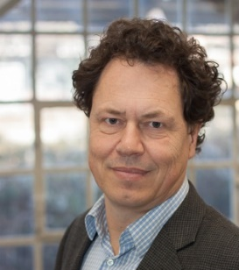
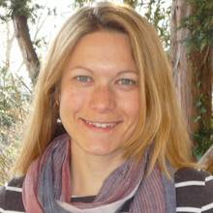
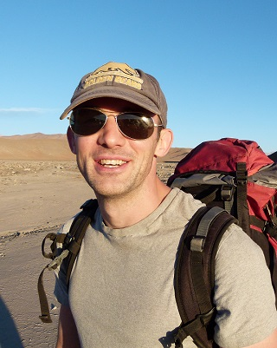
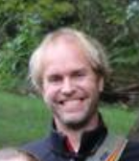
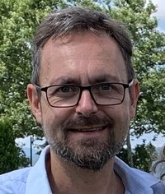
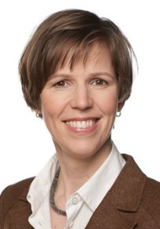
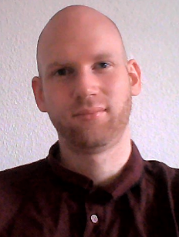
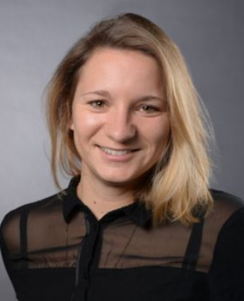
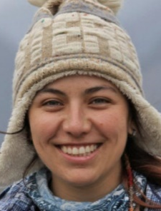
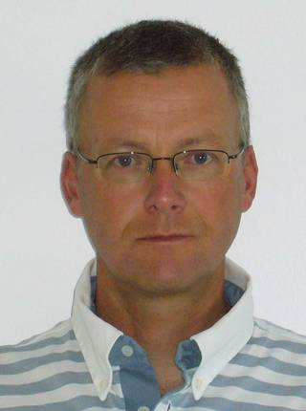
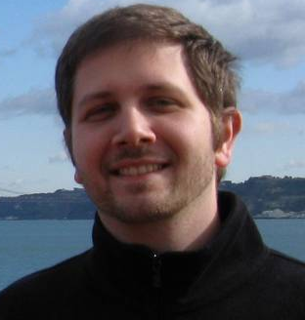
Subject representatives (professors)
GSGS Steering Committee as from 6 May 2021
Geography
Academic staff representative
Prof Dr Boris Braun Spokesperson
Prof Dr Tony Reimann (deputy)
Dr Kerstin Ebell
Dr Steven Binnie (deputy)
Geophysics, Meteorology
(StCom)
Steering Committee
Dr Karin Boessenkool (GSGS Coordinator)
2
2
2
2
coord
1
2
Prof Dr Roel Neggers
Prof Dr Joachim Saur (deputy)
Doctoral Representatives
Geology & Mineralogy, Crystallography
Stephan Schlegel (Academic staff)
Sarah Luft (Acad. staff, deputy)
Sarah Rabe (PhD student)
Barbara Blanco (PhD student, deputy)
Prof Dr Bernd Wagner
Prof Dr Patrick Grunert (deputy)

Slide 10
University of Cologne
Department of Geosciences
Geology & Mineralogy, Crystallography
Geography
non-professorial
academic staff (Dr)
Geophysics, Meteorology
supervising members (Prof/PD)
The Doctoral Representatives are encouraged to be part of the Doctoral Council
external supervising members (Prof/Dr)
(StCom)
Steering Committee
2
2
The GSGS Doctoral Council is a self-governing body of doctoral candidate members
2
2
coord
1
2
For further information, watch video #2 ‘candidate representation’
GSGS “Doctoral Council”
doctoral candidate members
“Doctoral Assembly”

Slide 11
University of Cologne
Department of Geosciences
For further information about the structure, governance and organisation of the GSGS, visit https://geosciences.uni-koeln.de/gsgs/about/organisation

